Slide 1
Microsoft Azure Administration | Development
Modul 6 – Microsoft Azure| Logic Apps

Slide 2
Inhalte
Hands OnLab
02
Lab 6.1
Lab 6.2
Logic Apps
01

Slide 3
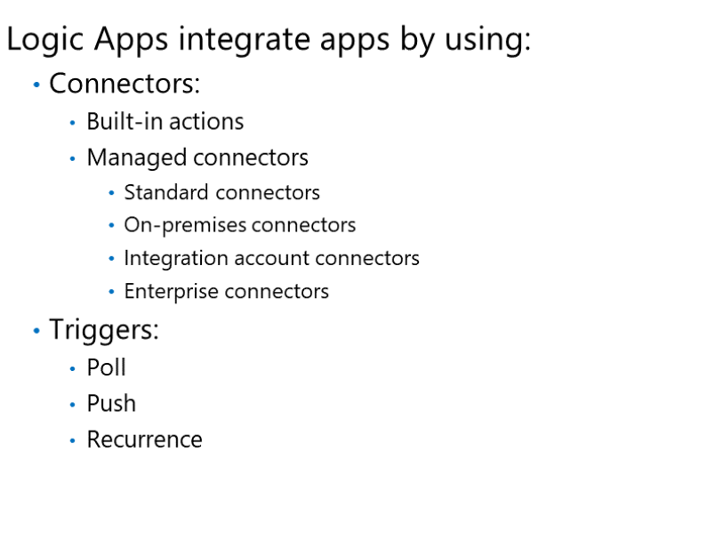
Azure Logic Apps

Slide 4
DEMO: Logic Apps
Notes:
Portal
Powershell / CLI

Slide 5
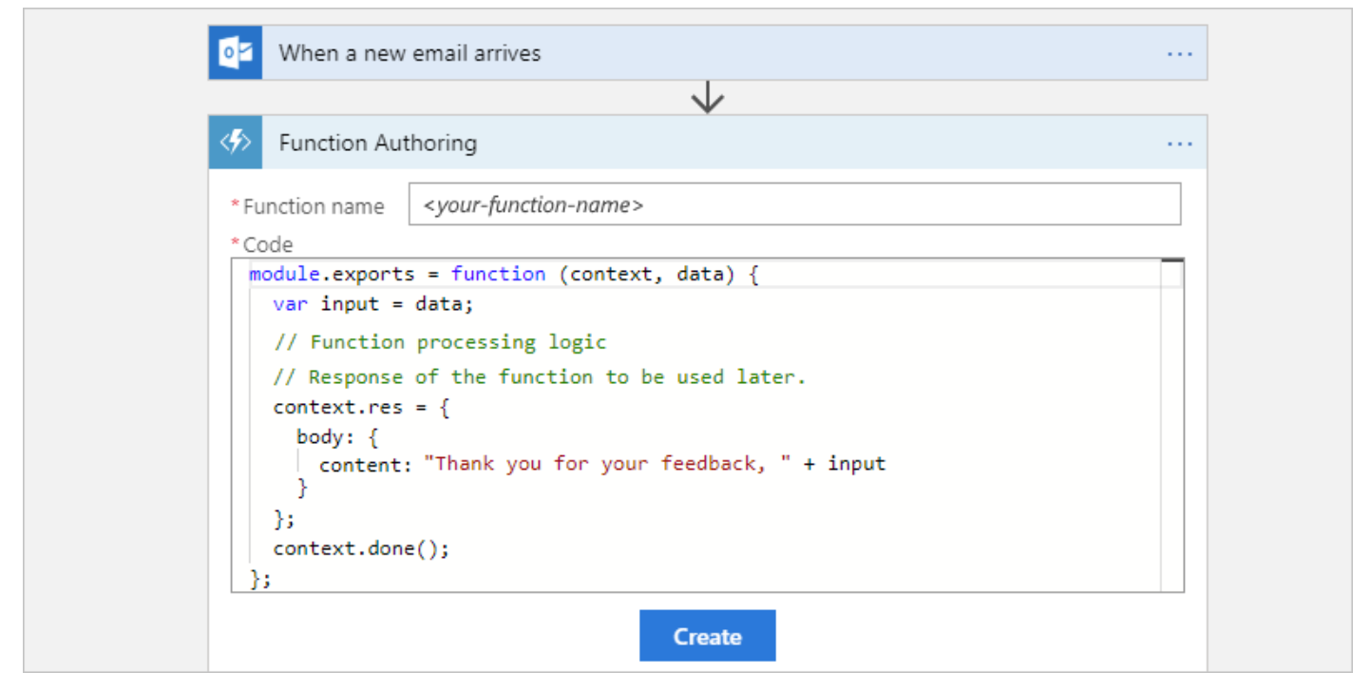
Azure Logic Apps & Functions

Slide 6
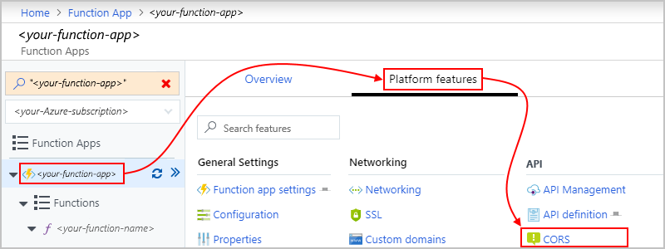
Azure Logic Apps & Functions

Slide 7
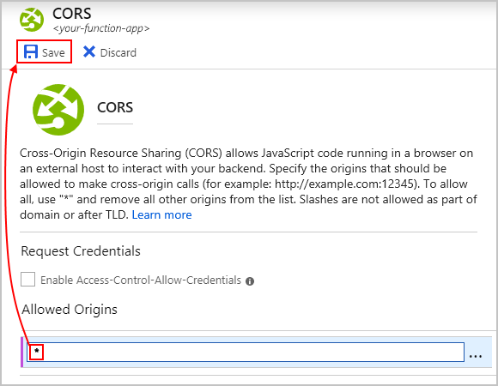
Azure Logic Apps & Functions

Slide 8
DEMO: Logic Apps & Functions
Notes:
Portal
Powershell / CLI

Slide 9
DEMO: Integration Logic Apps <> Functions
Notes:
Portal
Powershell / CLI

Slide 10
Lab 6.1 Deployment von Logic Apps
Notes:
Portal
Powershell / CLI

Slide 11
Fragen?

